Slide 1
6 Inner Product Spaces

Slide 2
6.1 Inner Products

Slide 3
Definition
An inner product on a real vector space V is a function that associates a real number <u, v> with each pair of vectors u and v in V in such a way that the following axioms are satisfied for all vectors u, v, and w in V and all scalars k.
<u, v>=<v, u> [Symmetry axiom]
<u+v, w>=<u, w>+<v, w> [Additivity axiom]
<ku, v>=k<u, v> [Homogeneity axiom]
<u, v>≧0 [Positivity axiom]
and <u, v>=0
if and only if v=0
A real vector space with an inner product is called a real inner product space.

Slide 4
Example 1
Euclidean Inner Product on R^{n}
If u=(u₁, u₂, …, u_{n}) and v=(v₁, v₂, …, v_{n}) are vectors in R^{n}, then the formula
<u, v>=u‧v=u₁v₁+u₂v₂+ …+u_{n}v_{n}
defines <u, v> to be the Euclidean product on R^{n}. The four inner product axioms hold by Theorem 4.1.2.

Slide 5
Example 2
Weighted Euclidean Product (1/2)
Let u=(u₁, u₂) and v =(v₁, v₂) be vectors in R². Verify that the weighted Euclidean inner product
<u, v>=3u₁v₁+2u₂v₂
satisfies the four product axioms.
Solution.
Note first that if u and v are interchanged in this equation, the right side remains the same. Therefore,
<u, v>=<v, u>
if w=(w₁, w₂), then
<u+v, w>=(3u₁w₁+2u₂w₂)+(3v₁w₁+2v₂w₂)=<u, w>+<v, w>
which establishes the second axiom.

Slide 6
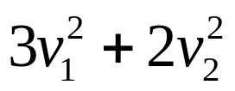
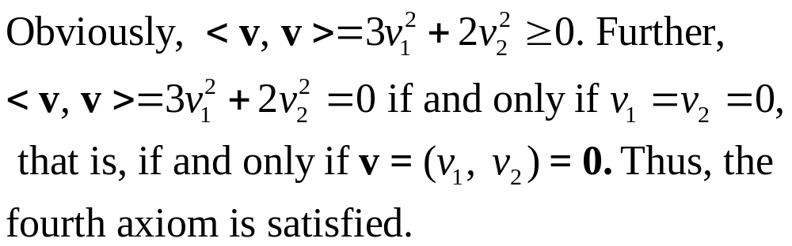
Example 2
Weighted Euclidean Product (2/2)
Next,
<ku, v>=3(ku₁)v₁+2(ku₂)v₂=k(3u₁v₁+2u₂v₂)=k<u, v>
which establishes the third axiom.
Finally,
<v, v>=3v₁v₁+2v₂v₂=

Slide 7

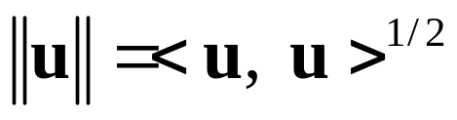
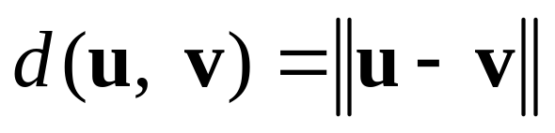
Definition
If V is an inner product space, then the norm (or length) of a vector u in V is denoted by and is defined by
The distance between two points (vectors) u and v is denoted by d(u, v) and is defined by

Slide 8
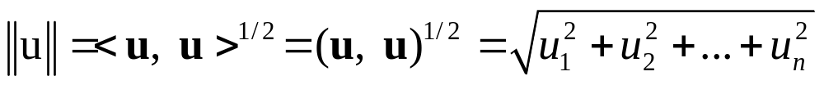
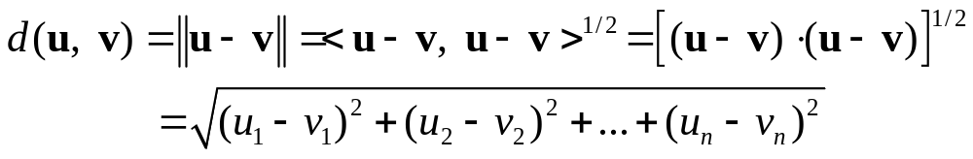
Example 3
Norm and Distance in R^{n}
If u=(u₁, u₂, …, u_{n}) and v=(v₁, v₂, …, v_{n}) are vectors in R^{n} with the Euclidean inner product, then
And
Observe that these are simply the standard formulas for the Euclidean norm and distance discussed in Section 4.1.

Slide 9
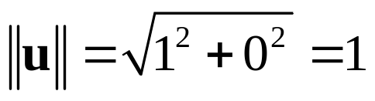
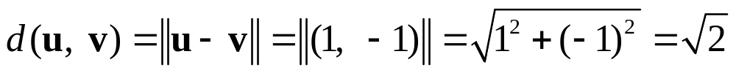
Example 4
Using a Weighted Euclidean Inner Product (1/2)
It is important to keep in mind that norm and distance depend on the inner product being used. If the inner product is changed, then the norms and distances between vectors also change. For example, for the vectors u=(1,0) and v=(0,1) in R² with the Euclidean inner product, we have
and

Slide 10
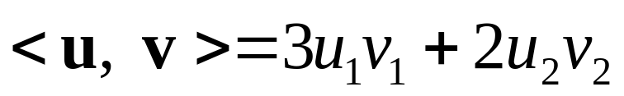
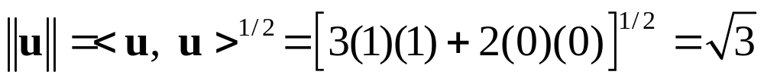
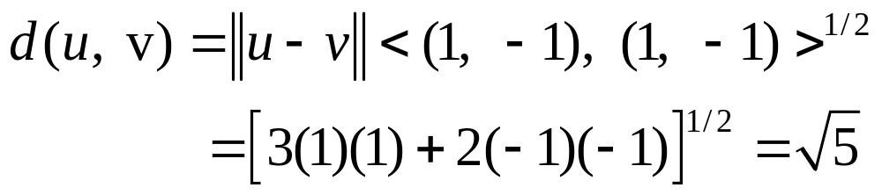
Example 4
Using a Weighted Euclidean Inner Product (2/2)
However, if we change to the weighted Euclidean inner product
then we obtain
and

Slide 11
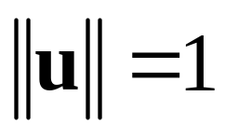
Unit Circles and Spheres in Inner Product Spaces
If V is an inner product space, then the set of points in V that satisfy
is called the unite sphere or sometimes the unit circle in V. In R² and R³ these are the points that lie 1 unit away form the origin.

Slide 12
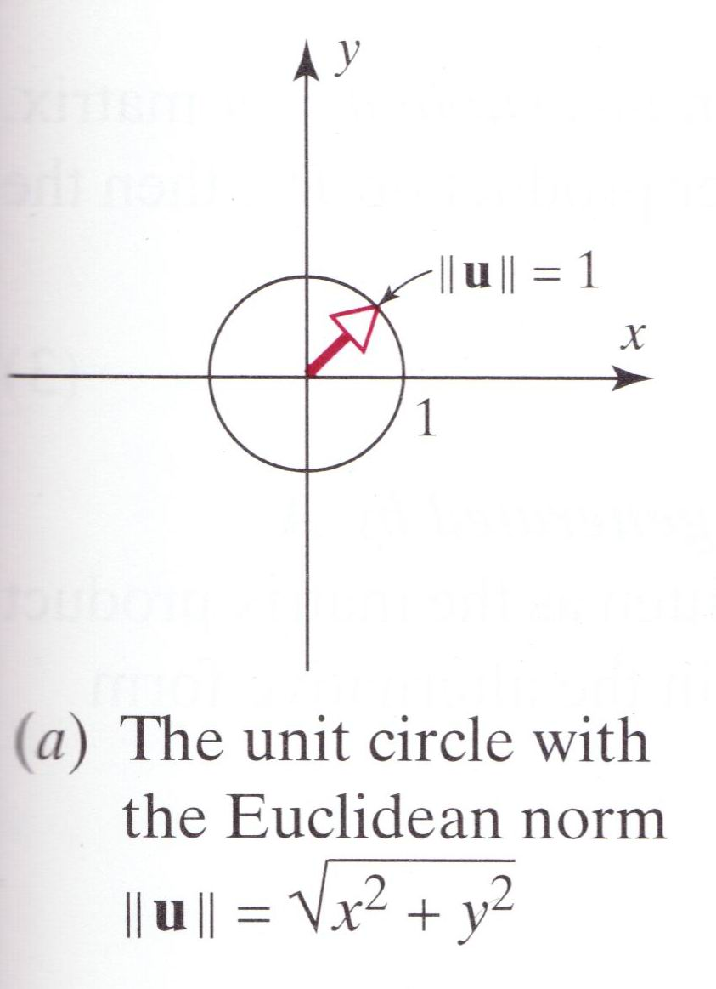
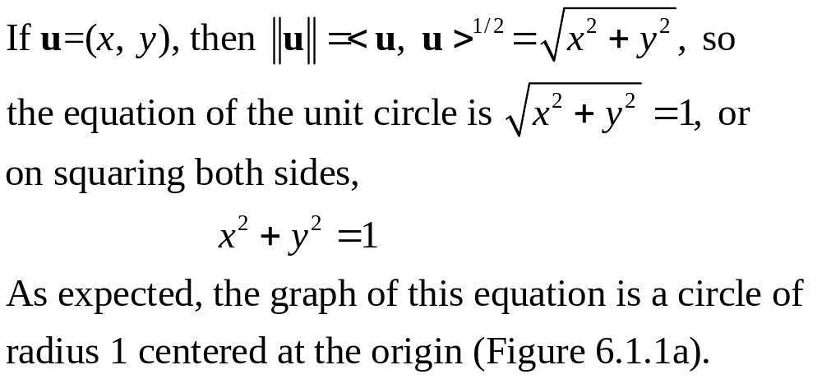
Example 5
Unusual Unit Circles in R² (1/2)
Sketch the unit circle in an xy-coordinate system in R² using the Euclidean inner product <u, v>=u₁v₁+u₂v₂.
Sketch the unit circle in an xy-coordinate system in R² using the Euclidean inner product <u, v>=1/9u₁v₁+1/4u₂v₂.
Solution (a).

Slide 13
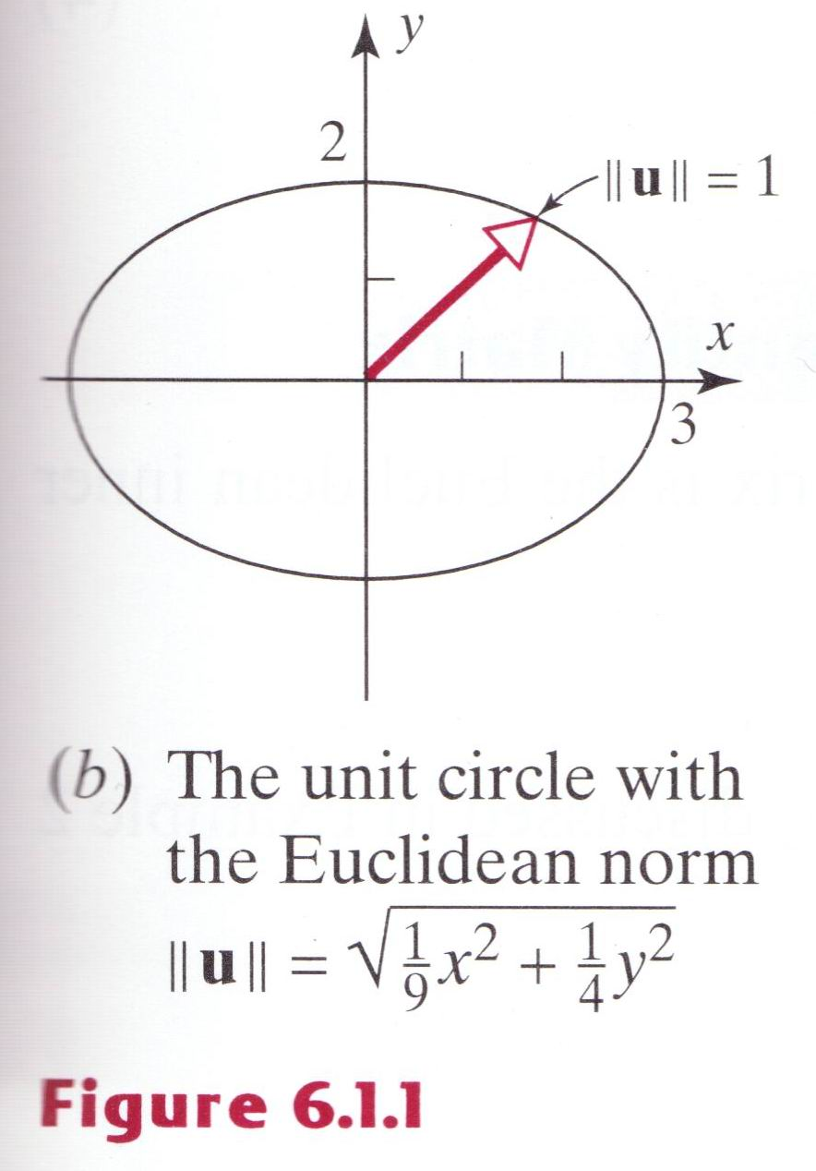
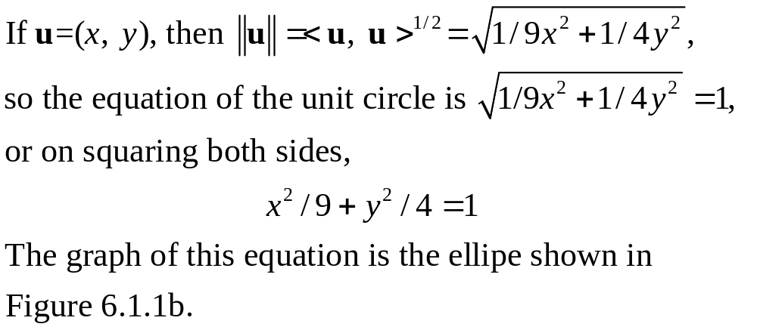
Example 5
Unusual Unit Circles in R² (2/2)
Solution (b).

Slide 14
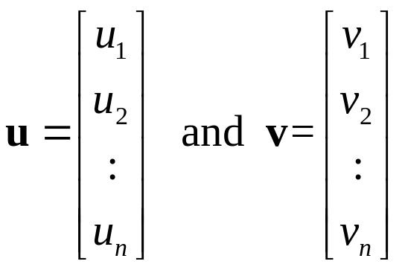
Inner Products Generated by Matrices (1/2)
The Euclidean inner product and the weighted Euclidean inner products are special cases of a general class of inner products on R^{n}, which we shall now describe. Let
be vectors in R^{n} (expressed as n×1 matrices), and let Abe an invertible n×n matrix. It can be shown that if u‧v is the Euclidean inner product on R^{n}, then the formula

Slide 15
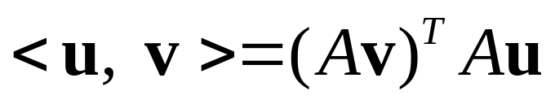
Inner Products Generated by Matrices (2/2)
defines an inner product; it is called the inner product on R^{n} generated by A.
Recalling that the Euclidean inner product u‧v can be written as the matrix product v^{T}u, it follows that (3) can be written in the alternative form
or equivalently,

Slide 16


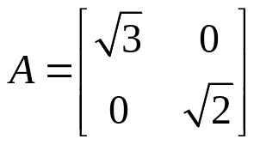
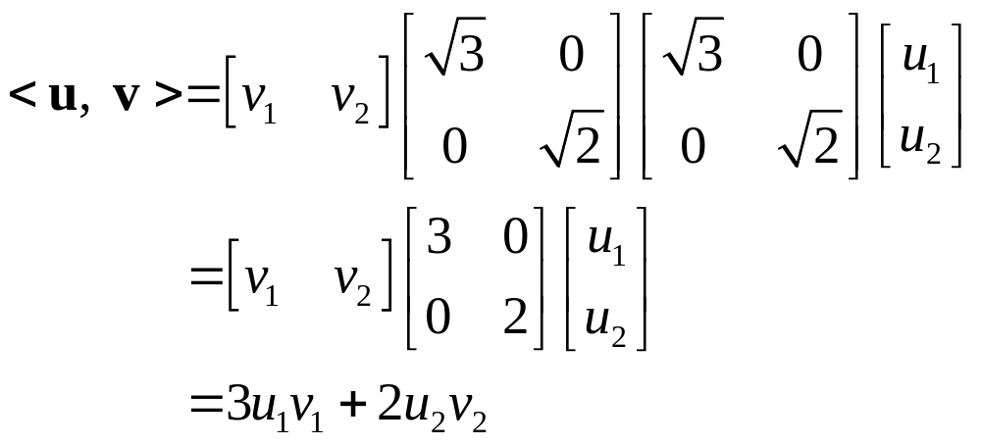
Example 6
Inner Product Generated by the Identity Matrix (1/2)
The inner product on R^{n} generated by the n×n identity matrix is the Euclidean inner product, since substituting A=I in (3) yields
The weighted Euclidean inner product discussed in Example 2 is the inner product on R2 generated by
because substituting this in (4) yields

Slide 17
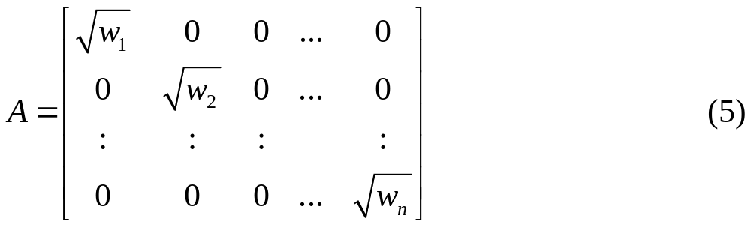
Example 6
Inner Product Generated by the Identity Matrix (2/2)
In general, the weighted Euclidean inner product
is the inner product on R^{n} generated by

Slide 18
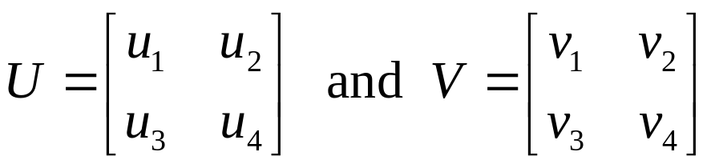
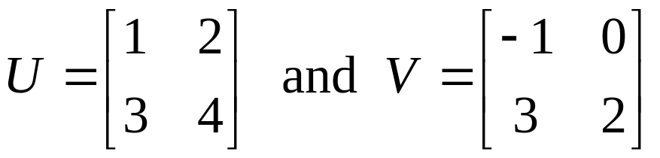
Example 7
An Inner Product on M₂₂ (1/2)
If
are an two 2×2 matrices, then the following formula defines an inner product on M₂₂:
For example, if
then

Slide 19
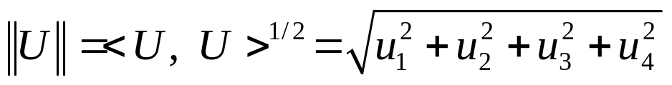
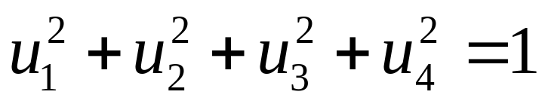
Example 7
An Inner Product on M₂₂ (2/2)
the norm of a matrix U relative to this inner product is
and the unit sphere in this space consists of all 2×2 matrices U whose entries satisfy the equation ∥U∥=1, which on squaring yields

Slide 20
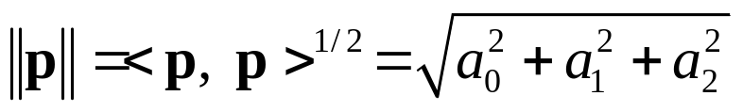
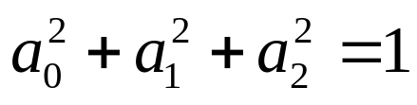
Example 8
An Inner Product on P₂
If
p=a₀+a₁x+a₂x² and q=b₀+b₁x+b₂x²
are any two vectors in P₂, then the following formula defines an inner product on P₂:
<p, q>=a₀b₀+a₁b₁+a₂b₂
The norm of the polynomial p relative to this inner product is
and the unit sphere in this space consists of all polynomials p in P₂ whose coefficients satisfy the equation ∥p∥=1, which on squaring yields

Slide 21
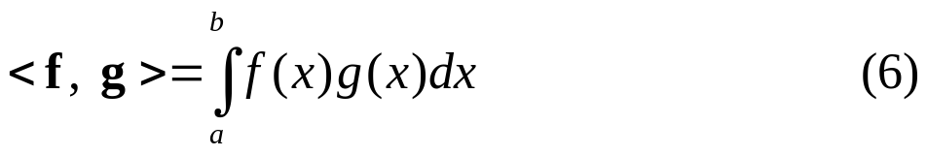
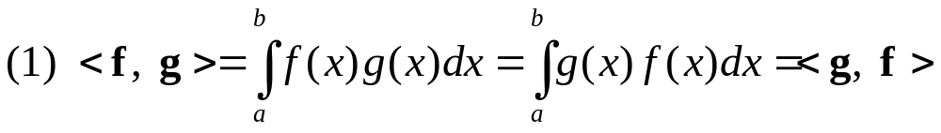
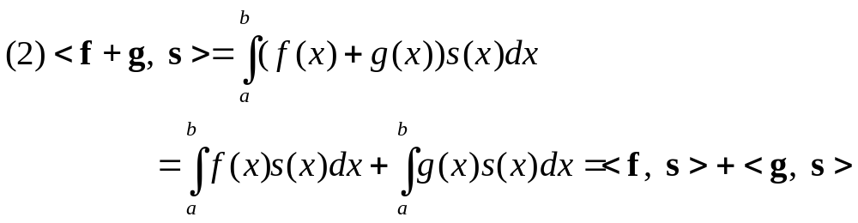
Example 9
An Inner Product on C[a, b] (1/2)
Let f=f(x) and g=g(x) be two continuous functions in C[a, b] and define
We shall show that this formula defines an inner product on C[a, b] by verifying the four inner product axioms for functions f=f(x), g=g(x), and s=s(x) in C[a, b]:
which proves that Axiom 1 holds.
which proves that Axiom 2 holds.

Slide 22
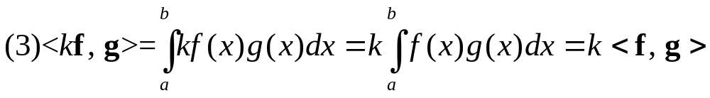
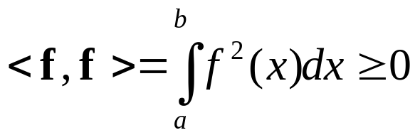
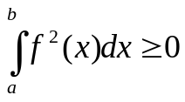
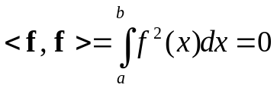
Example 9
An Inner Product on C[a, b] (2/2)
which proves that Axiom 3 holds.
(4)If f=f(x) is any function in C[a, b], then f ²(x)≧0 for all x in [a, b]; therefore,
Further, because f ²(x)≧0 and f=f(x) is continuous on [a, b], it follows that if and only if f(x)=0 for all x in [a, b]. Therefore, we have if and only if f=0. This proves that Axiom 4 holds.

Slide 23
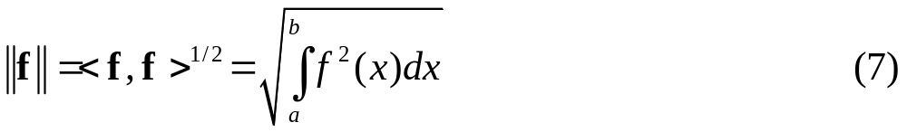
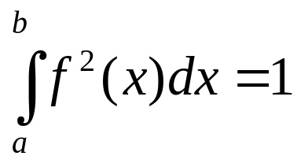
Example 10
Norm of a Vector in C[a, b]
If C[a, b] has the inner product defined in the preceding example, then the norm of a function f=f(x) relative to this inner product is
and the unit sphere consists of all functions f in C[a, b] that satisfy the equation ∥f∥=1, which on squaring yields

Slide 24
Theorem 6.1.1
Properties of Inner Products
If u, v, and w are vectors in a real inner product space, and k is any scalar, then:
<0, v>=<v, 0>=0
<u, v+w>=<u, v>+<u, w>
<u, kv>=k<u, v>
<u-v, w>=<u, w>-<v, w>
<u, v-w>=<u, v>-<u, w>

Slide 25
Example 11
Calculating with Inner Products
<u-2v, 3u+4v>=<u, 3u+4v>-<2v, 3u+4v>
=<u, 3u>+<u, 4v>-<2v, 3u>-<2v, 4v>
=3<u, u>+4<u, v>-6<v, u>-8<v, v>
=3∥u∥²+4<u, v>-6<u, v>-8∥v∥²
= 3∥u∥²-2<u, v>-8∥v∥²

Slide 26
6.2 Angle And Orthogonality In Inner Product Spaces

Slide 27
Theorem 6.2.1
Cauchy-Schwarz Inequality
If u and v are vectors in a real inner product space, then
|<u, v>|≦∥u∥∥v∥ (4)

Slide 28
Example 1
Cauchy-Schwarz Inequality in R^{n}
The Cauchy-Schwarz inequality for R^{n} (Theorem 4.1.3) follows as a special case of Theorem 6.2.1 by taking <u, v> to be the Euclidean inner product u‧v.

Slide 29
Theorem 6.2.2
Properties of Length
If u and v are vectors in an inner product space V, and if k is any scalar, then :
∥u∥≧0
∥u∥=0 if and only if u=0
∥ku∥=∣k∣∥u∥
∥u+v∥≦∥u∥+∥v∥ (Triangle inequality)

Slide 30
Theorem 6.2.3
Properties of Distance
If u, v, and w are vectors in an inner product space V, and if k is any scalar, then:
d(u, v)≧0
d(u, v)=0 if and only if u=v
d(u, v)=d(v, u)
d(u, v)≦d(u, w)+d(w, v) (Triangle inequality)

Slide 31
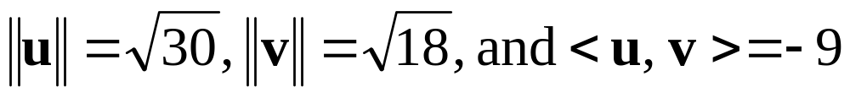
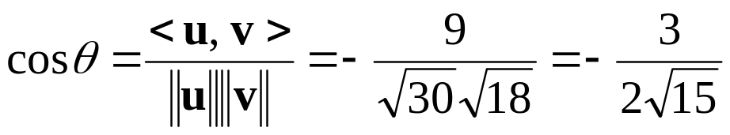
Example 2
Cosine of an Angle Between Two Vectors in R⁴
Let R⁴ have the Euclidean inner product. Find the cosine of the angle θ between the vectors u=(4, 3, 1, -2) and v=(-2, 1, 2, 3).
Solution.
We leave it for the reader to verify that
so that

Slide 32
Definition
Two vectors u and v in an inner product space are called orthogonal if <u, v>=0.

Slide 33
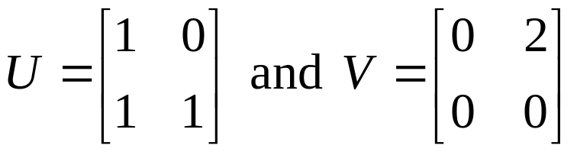
Example 3
Orthogonal Vectors in M₂₂
If M₂₂ has the inner project of Example 7 in the preceding section, then the matrices
Are orthogonal, since

Slide 34
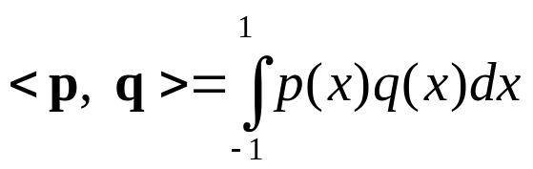
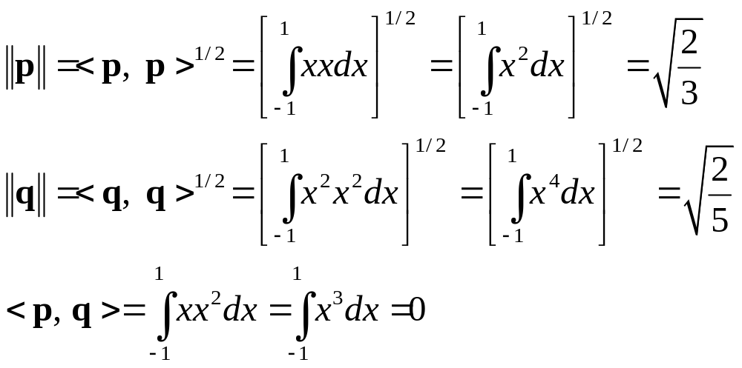
Example 4
Orthogonal Vectors in P₂
Let P₂ have the inner product
and let p=x and q=x ². Then
Because <p, q>=0, the vectors p=x and q=x ² are orthogonal relative to the given inner product.

Slide 35
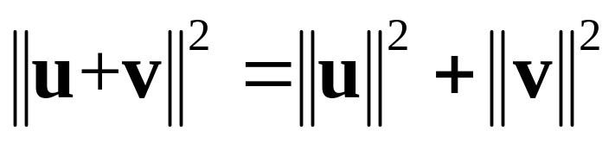
Theorem 6.2.4
Generalized Theorem of Pythagoras
If u and v are orthogonal vectors in an inner product space, then

Slide 36
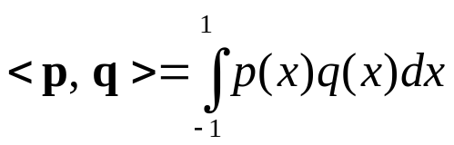
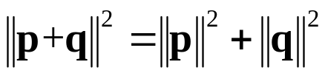
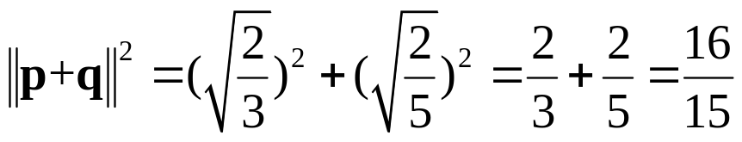
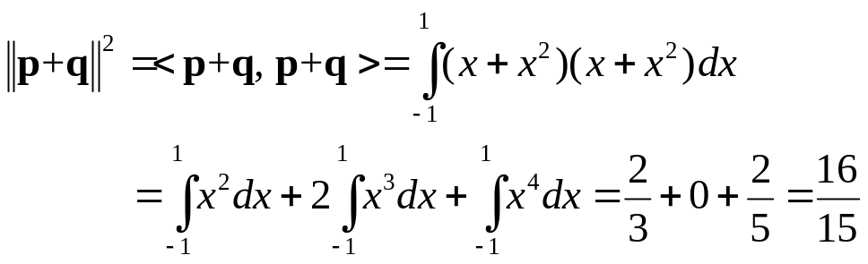
Example 5
Theorem of Pythagoras in P₂
In Example 4 we shoed that p=x and q=x ² are orthogonal relative to the inner product
on P₂. It follows from the Theorem of Pythagoras that
Thus, from the computations in Example 4 we have
We can check this result by direct integration:

Slide 37
Definition
Let W be a subspace of an inner product space V. A vector u in V is said to be orthogonal to W if it is orthogonal to every vector in W, and the set of all vectors in V that are orthogonal to W is called the orthogonal complement of W.

Slide 38
Theorem 6.2.5
Properties of Orthogonal Complements
If W is a subspace of a finite-dimensional inner product space V, then:
W⊥ is a subspace of V.
The only vector common to W and W⊥ is 0.
The orthogonal complement of W⊥ is W; that is , (W⊥)⊥=W.

Slide 39
Theorem 6.2.6
If A is an m×n matrix, then:
The nullspace of A and the row space of A are orthogonal complements in R^{n} with respect to the Euclidean inner product.
The nullspace of A^{T} and the column space of A are orthogonal complements in R^{m} with respect to the Euclidean inner product.

Slide 40
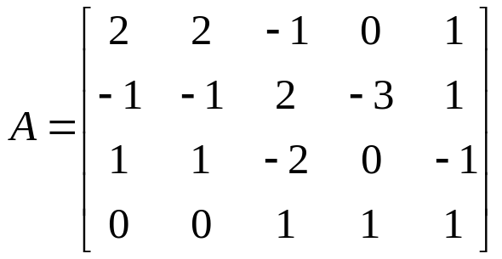
Example 6
Basis for an Orthogonal Complement (1/2)
Let W be the subspace of R⁵ spanned by the vectors w₁=(2, 2, -1, 0, 1), w₂=(-1, -1, 2, -3, 1), w₃=(1, 1, -2, 0, -1), w₄=(2, 2, -1, 0, 1). Find a basis for the orthogonal complement of W.
Solution.
The space W spanned by w₁, w₂, w₃, and w₄ is the same as the row space of the matrix
and by part (a) of Theorem 6.2.6 the nullspace of A is the orthogonal complement of W. In Example 4 of Section 5.5 we showed that

Slide 41
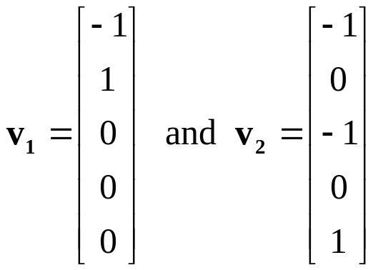
Example 6
Basis for an Orthogonal Complement (2/2)
Form a basis for this nullspace. Expressing these vectors in the same notation as w₁, w₂, w₃, and w₄, we conclude that the vectors
v₁=(-1, 1, 0, 0, 0) and v₂=(-1, 0, -1, 0, 1)
form a basis for the orthogonal complement of W. As a check, the reader may want to verify that v₁ and v₂ are orthogonal to w₁, w₂, w₃, and w₄ by calculating the necessary dot products.

Slide 42
Theorem 6.2.7
Equivalent Statements (1/2)
If A is an n×n matrix, and if T_{A}: R^{n} → R^{n} is multiplication by A, then the following are equivalent.
A is invertible.
Ax=0 has only the trivial solution.
The reduced row-echelon form of A is I_{n}.
A is repressible as a product of elementary matrices.
Ax=b is consistent for every n×1 matrix b.
Ax=b has exactly one solution for every n×1 matrix b.
det(A)≠0.
The range of T_{A} is R^{n}.
T_{A} is one-to-one.

Slide 43
Theorem 6.2.7
Equivalent Statements (2/2)
The column vectors of A are linearly independent.
The row vectors of A are linearly independent.
The column vectors of A span R^{n}.
The row vectors of A span R^{n}.
The column vectors of A form a basis for R^{n}.
The row vectors of A form a basis for R^{n}.
A has rank n.
A has nullity 0.
The orthogonal complement of the nullspace of A is R^{n}.
The orthogonal complement of the row of A is {0}.

Slide 44
6.3 Orthonormal Bases; Gram-Schmidt Process; QR-Decomposition

Slide 45
Definition
A set of vectors in an inner product space is called an orthogonal set if all pairs of distinct vectors in the set are orthogonal. An orthogonal set in which each vector has norm 1 is called orthonormal.

Slide 46
Example 1
An Orthonormal Set in R³
Let u₁=(0, 1, 0), u₂=(1, 0, 1), u₃=(1, 0, -1) and assume that R³ has the Euclidean inner product. It follows that the set of vectors S={u₁, u₂, u₃} is orthogonal since <u₁, u₂>=<u₁, u₃>=<u₂, u₃>=0.

Slide 47
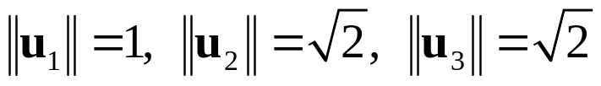
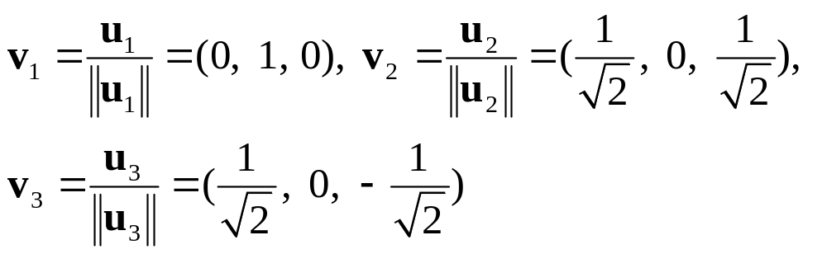
Example 2
Constructing an Orthonormal Set
The Euclidean norms of the vectors in Example 1 are
Consequently, normalizing u₁, u₂, and u₃ yields
We leave it for you to verify that set S={v₁, v₂, v₃} is orthonormal by showing that

Slide 48
Theorem 6.3.1
If S={v₁, v₂, …, v_{n}} is an orthonormal basis for an inner product space V, and u is any vector in V, then
u=<u, v₁>v₁+<u, v₂>v₂+…+<u, v_{n}>v_{n}

Slide 49
Example 3
Coordinate Vector Relative to an Orthonormal Basis
Let v₁=(0, 1, 0), v₂=(-4/5, 0, 3/5), v₃=(3/5, 0, 4/5). It is easy to check that S={v₁, v₂, v₃} is an orthonormal basis for R³ with the Euclidean inner product. Express the vector u=(1, 1, 1) as a linear combination of the vectors in S, and find the coordinate vector (u)_{s}.
Solution.
<u, v₁>=1, <u, v₂>=-1/5, <u, v₃>=7/5
Therefore, by Theorem 6.3.1 we have
u=v₁-1/5v₂+7/5v₃
that is,
(1, 1, 1)=(0, 1, 0)-1/5(-4/5, 0, 3/5)+7/5(3/5, 0, 4/5)
The coordinate vector of u relative to S is
(u)_{s}=(<u, v₁>, <u, v₂>, <u, v₃>)=(1, -1/5, 4/5)

Slide 50



Theorem 6.3.2
If S is an orthonormal basis for an n-dimensional inner product space, and if
(u)_{s}=(u₁, u₂, …, u_{n}) and (v)_{s}=(v₁, v₂, …, v_{n})
then:
∥u∥=
d(u, v)=
<u, v>=

Slide 51



Example 4
Calculating Norms Using Orthonormal Bases
If R³ has the Euclidean inner product, then the norm of the vector u=(1, 1, 1) is
However, if we let R³ have the orthonormal basis S in the last example, then we know from that example that the coordinate vector of u relative to S is
The norm of u can also be calculated from this vector using part (a) of Theorem 6.3.2. This yields

Slide 52
Theorem 6.3.3
If S={v₁, v₂, …, v_{n}} is an orthogonal set of nonzero vectors in an inner product space, then S is linearly independent.

Slide 53

Example 5
Using Theorem 6.3.3
In Example 2 we showed that the vectors
form an orthonormal set with the respect to the Euclidean inner product on R³. By Theorem 6.3.3 these vectors form a linearly independent set, and since R³ is three-dimensional, S={v₁, v₂, v₃} is an orthonormal basis for R³ by Theorem 5.4.5.

Slide 54
Theorem 6.3.4
Project Theorem
If W is a finite-dimensional subspace of an product space V, then every vector u in V can be expressed in exactly one way as
u=w₁+w₂ (3)
where w₁ is in W and w₂ is in W⊥.

Slide 55


Theorem 6.3.5
Let W be a finite-dimensional subspace of an inner product space V.
If {v₁, v₂, …, v_{r}} is an orthonormal basis for W, and u is any vector in V, then
If {v₁, v₂, …, v_{r}} is an orthonormal basis for W, and u is any vector in V, then

Slide 56



Example 6
Calculating Projections
Let R³ have the Euclidean inner, and let W be the subspace spanned by the orthonormal vectors v₁=(0, 1, 0) and v₂=(-4/5, 0, 3/5). From (6) the orthogonal projection of u=(1, 1, 1) on W is
The component of u orthogonal to W is
Observe that is orthogonal to both v₁ and v₂ so that this is orthogonal to each vector in the space W spanned by v₁ and v₂ as it should be.

Slide 57
Theorem 6.3.6
Every nonzero finite-dimensional inner product space has an orthonormal basis.

Slide 58

Example 7
Using the Gram-Schmidt Process (1/2)
Consider the vector space R³ with the Euclidean inner product. Apply the Gram-Schmidt process to transform the basis vectors u₁=(1, 1, 1), u₂=(0, 1, 1), u₃=(0, 0, 1) into an orthogonal basis {v₁, v₂, v₃}; then normalize the orthogonal basis vectors to obtain an orthonormal basis{q₁, q₂, q₃}.
Solution.
Step 1. v₁=u₁=(1, 1, 1)
Step 2.

Slide 59



Example 7
Using the Gram-Schmidt Process (2/2)
Step 3.
Thus,
v₁=(1, 1, 1), v₂=(-2/3, 1/3, 1/3), v₃=(0, -1/2, 1/2)
form an orthogonal basis for R³. The norms of these vectors are
so an orthonormal basis for R³ is

Slide 60
Theorem 6.3.7
QR-Decomposition
If A is an m×n matrix with linearly independent column vectors , then A can be factored as
A=QR
where Q is an m×n matrix with orthonormal column vectors, and R is an n×n invertible upper triangular matrix.

Slide 61



Example 8
QR-Decomposition of a 3×3 Matrix (1/2)
Find the QR-decomposition of
Solution.
The column vectors A are
Applying the Gram-Schmidt process with subsequent normalization to these column vectors yields the orthonormal vectors

Slide 62


Example 8
QR-Decomposition of a 3×3 Matrix (2/2)
and the matrix R is
Thus, the QR-decomposition of A is
A Q R

Slide 63
The Role of the QR-Decomposition in Linear Algebra
In recent years the QR-decomposition has assumed growing importance as the mathematical foundation for a wide variety of practical algorithms, including a widely used algorithm for computing eigenvalues of large matrices.

